Slide 1
Computer Architecture
Chapter-2

Slide 2
Instruction: The words of a computer language is called instruction
Instruction set : The vocabulary of computer language is called instruction set.
Goal of the computer designer:
To find a language that makes it easy to build the hardware and compiler while maximizing performance and minimizing cost.

Slide 3
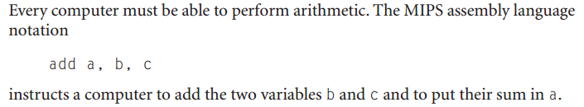
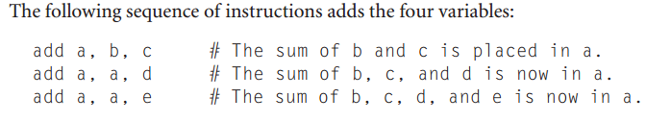
Operations of the computer hardware:
--per line one instruction
--must always have exactly three variables

Slide 4
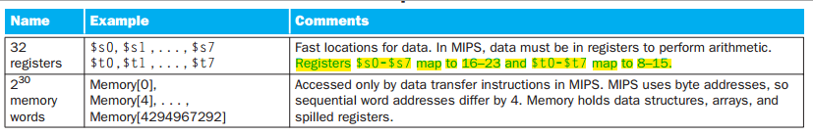
Operands of the computer hardware:

Slide 5
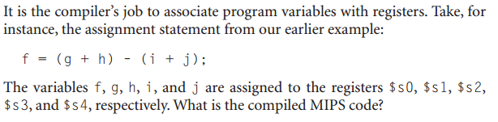

Answer:

Slide 6
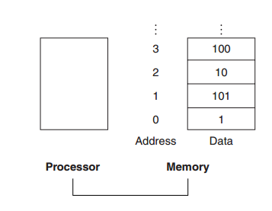
How computer hardware access large memory structure?
--- Data structures (array and structures) are used.
Data transfer instruction:
A command that moves data between memory and register
Memory to register = load
Register to memory = store

Slide 7

g=h + A[8]
Answer:
lw $t0, 8($s3) offset
base register
add $s1, $s2, $t0

Slide 8
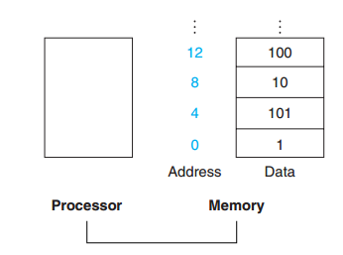
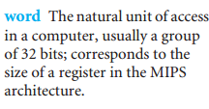
Alignment restriction:
Words must start at address that are multiples of 4.
Spilling register:
Process of putting less commonly used variable in a memory is called spilling register.

Slide 9
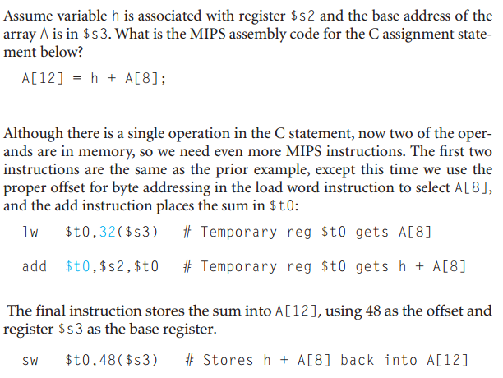

Slide 10
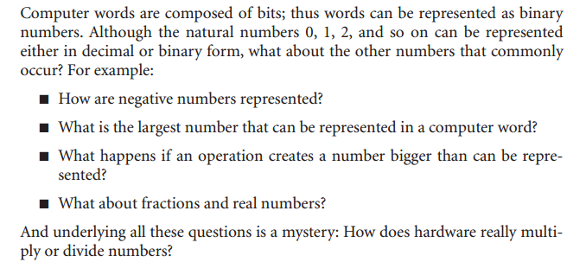

Slide 11
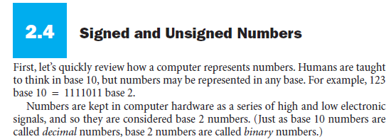
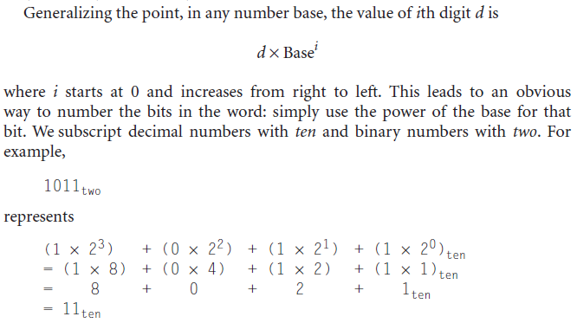

Slide 12
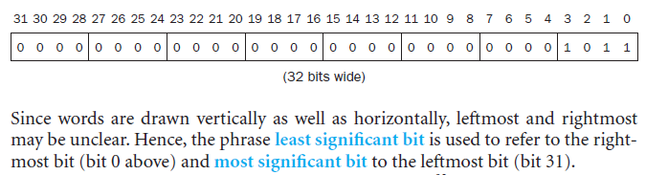

Slide 14
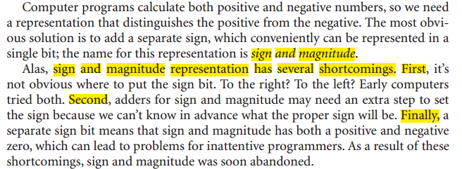

Slide 15
→To overcome this use 2’s complement
If MSB=0, it is positive number
If MSB=1, then it is negative number
0000=0 1000= -8 (-1*2^3 + 0*2^2+0*2^1+0*2^0)
0001=1 1001= -7
0010=2 1010= -6
0011=3 1011= -5
0100=4 1100= -4
0101=5 1101= -3
0110=6 1110= -2
0111=7 1111= -1

Slide 16
Rules to negate a two’s complement binary number:
Simply invert 0 to 1 and 1 to 0
Then add 1 to this result
Example:

Slide 17
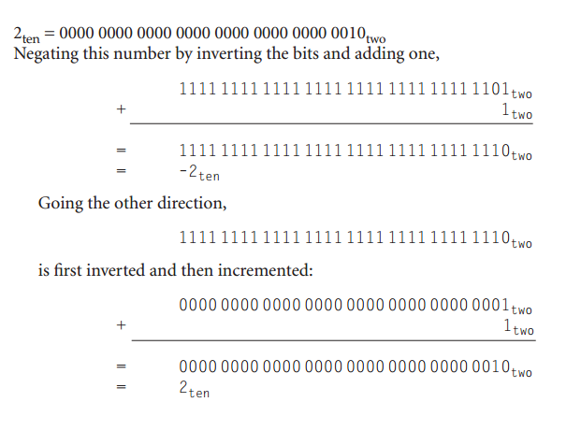
Self : (-100) ten to (100) ten

Slide 18
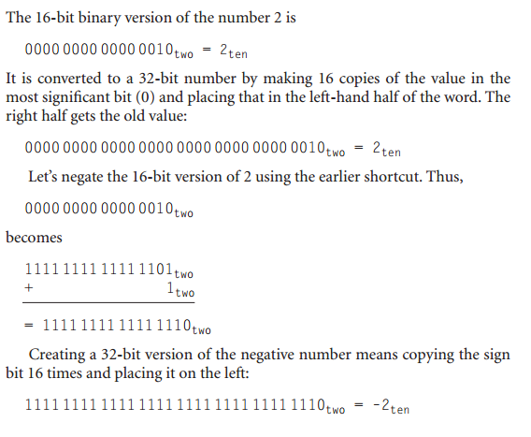
Example:
Answer:

Slide 19
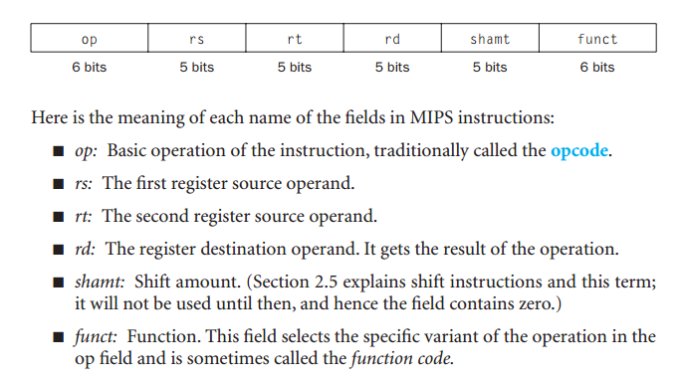
Representing Instructions in the computer:
R-type:

Slide 20
Example:
add $t0, $s1, $s2 Decimal representation:
op = 0
rd= $t0 = 8
rs= $s1 = 17 Binary representation:
rt= $s2 = 18
Shmt = 0
Funct = 32

Slide 21

I – format :
Example:
lw $t0, 32($s1)
j- type:
35 | 17 | 8 | 32
Op (6 bits) | Address (26 bits)

Slide 22
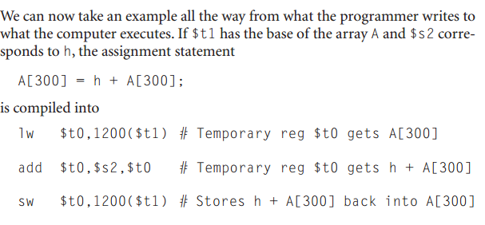
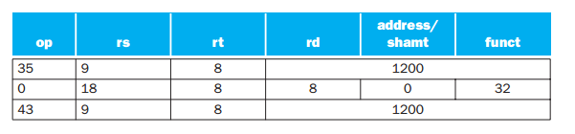

Slide 23
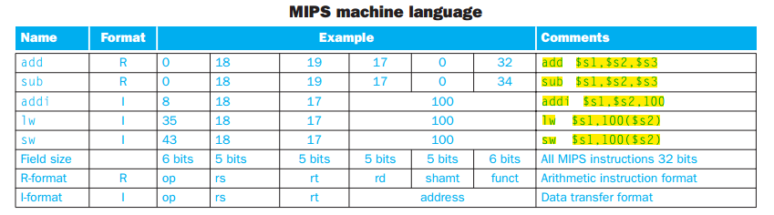

Slide 24
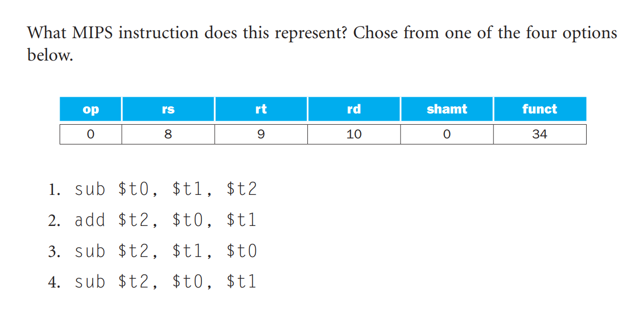

Slide 25
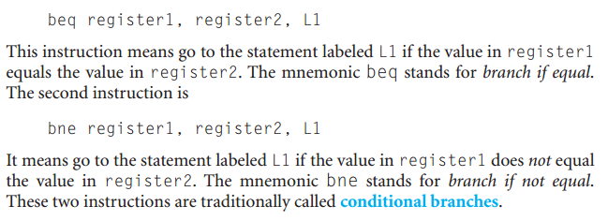
Logical Operations:

Slide 26
if ( i==j) go to L1;
f = g+h;
L1: f=f-i;
Convert this into MIPS assembly code.
Answer :
f= $s0, g= $s1, h= $s2, i= $s3, j= $s4
beq $s3, $s4, L1
add $s0, $s1, $s2
L1: sub $s0, $s0, $s3

Slide 27
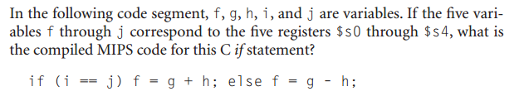
Answer:
bne $s3, $s4, ELSE
add $s0, $s1, $s2
j EXIT
ELSE:
sub $s0, $s1, $s2
EXIT
N.B: use jump in case of if… else

Slide 28
Loop: g= g + A[i]
i=i+j
If (i!=j) go to LOOP.
What will be the MIPS assemble code?
Answer:
g=$s1, h=$s2, i=$s3, j=$s4, A=$s5
Loop:
add $t1, $s3, $s3
add $t1, $t1, $t1
add $t1, $t1, $s5 // $t1= address of A[i] (4*i + $s3)
lw $t0, 0($t1) // used that address to load A[i] into a temporary register
add $s1, $s1, $t0
add $s3, $s3, $s4
bne $s3, $s4, LOOP
Rule for getting address of an array:
1.Multiply the index I by 4
2. Add with the base of array

Slide 29
while (save [i] = k )
i= i+j
what will be the MIPS assembly code for this?
Answer:
i=$s3, j=$s4, k=$s5, save = $s6
LOOP:
add $t1, $s3, $s3
add $t1, $t1, $t1
add $t1, $t1, $s6
lw $t0, 0($t1)
bne $t0, $s5, EXIT
add $s3, $s3, $s4
j LOOP
EXIT

Slide 30
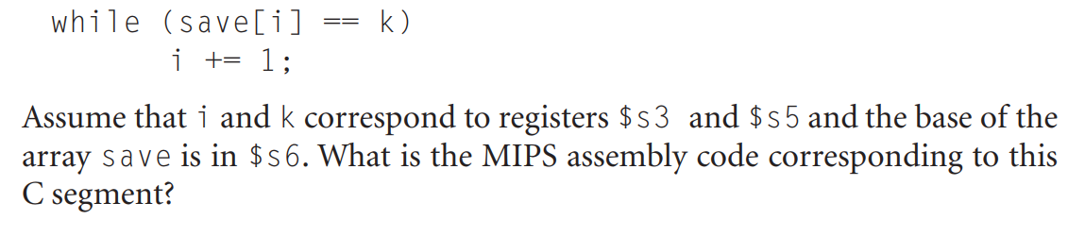
Solve:
Loop: sll $t1, $ s3, 2
Add $t1, $t1, $s6
lw $t0, 0($t1)
bne $t0, $s5, Exit
addi $s3,$s3,1
J loop
Exit:

